Slide 1
Chapter 11: Liquids & Intermolecular forces
Dr. Aimée Tomlinson
Chem
1212

Slide 2
Section 11.1
A Molecular Comparison of Gases, Liquids, and Solids

Slide 3
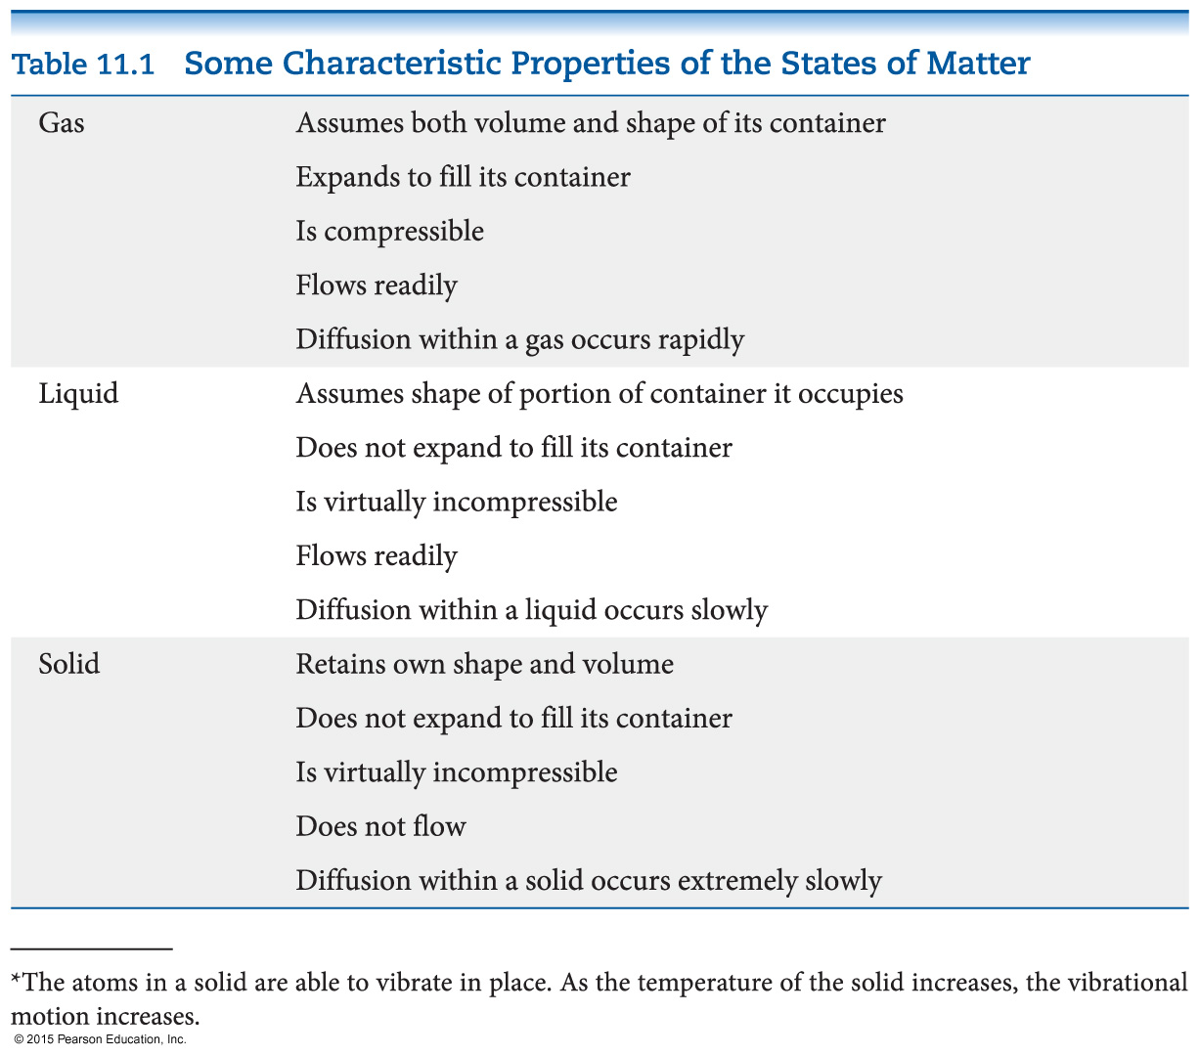
Differences in the States

Slide 4
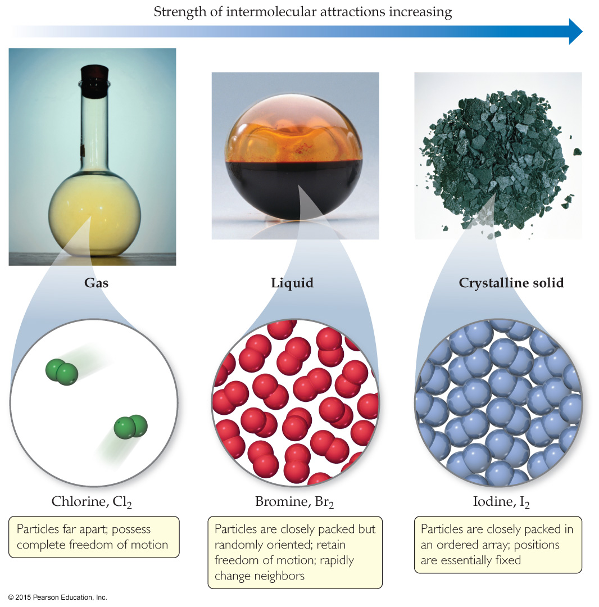
States of Matter
The fundamental difference between states of matter is the strength of the intermolecular forces of attraction.
Stronger forces bring molecules closer together.
Solids and liquids are referred to as the condensed phases.

Slide 5
States of Matter, KE, & Attraction
There is a balancing act between the Kinetic Energy & attractive forces between molecules

Slide 6
Before we talk about Intermolecular Forces we need to review what makes a polar bond and then a polar molecule

Slide 7
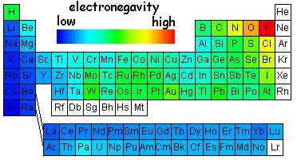
Recall the Electronegativity Trend
http://www.bpreid.com/3_bonding.php

Slide 8
Polar bonds
They result from a difference in electronegativity between the two atoms
We can represent them using an arrow aka a bond dipole
This arrow indicates the direction of pull on the electron density
Electrons are pulled towards the more EN atom leading to (-)
Since they are pulled from the less EN atom it leads to (+)
more EN atom (-)
Less EN atom (+)

Slide 9
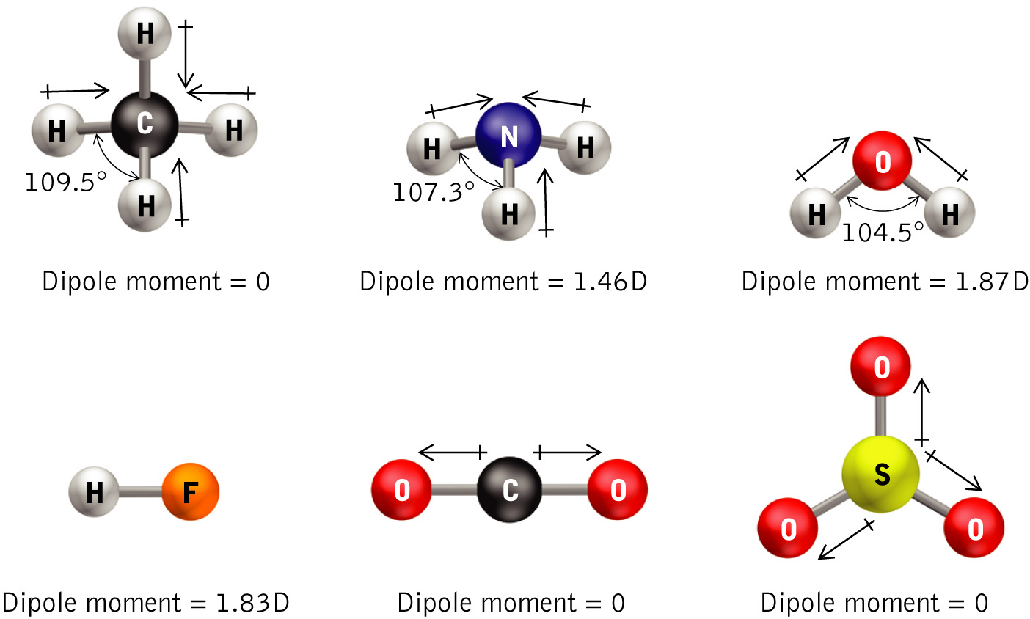
Polar Molecules
All the dipoles are treated like vectors
We add them all up and generate a permanent dipole moment (dpm)
We have a nonzero dpm for asymmetric molecules
Examples: NH₃, H₂O, SO₂, SF₄,
XeOF₄
Perfectly symmetric molecules will have a zero dpm (0 Debye or D)
Examples: CBr₄, BF₃, BeCl₂, PCl₅, I₃⁻, SF₆, XeF₄

Slide 10
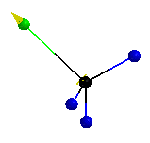
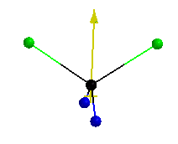
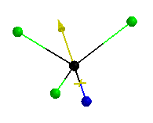
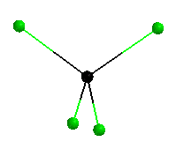
Symmetry trend using methane
CH₃Cl
CH₂Cl₂
DPM = 1.87D
DPM = 1.54D
CHCl₃
CCl₄
DPM = 1.02D
DPM = 0.0D

Slide 11
Non-Polar versus Polar
Non Polar Molecules
Have the same molecular & electronic geometries
Are completely symmetric
May possess polar bonds (e.g. CCl₄)
Polar Molecules
May have the same (CH₃Cl) or different (NH₃) molecular & electronic geometries
May have lone pairs on the central atom (e.g. H₂O)
Are not completely symmetric
Must possess polar bonds

Slide 12
Who’s Polar?
Kr SeClBr₃ MgO I₂ PH₃ H₂S NO

Slide 13
Section 11.2
Meaning between two molecules
Intermolecular Forces (IF)

Slide 14
Intermolecular vs. Intramolecular
Intermolecular
Intramolecular
Means between 2 or more molecules
Responsible for macroscopic properties:
- vapor pressure
- boiling/freezing/melting pts
- osmotic pressure
Means within one molecule
Responsible for:
- bond energies
- polarity

Slide 15
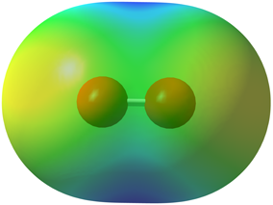
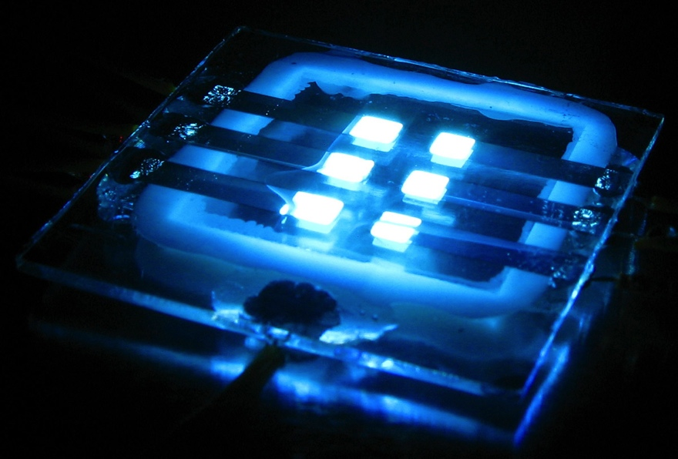
van der Waals gas constants
Water: 5.28 L² atm / mol²
The more red means it is electron rich
The more blue is electron poor
Water has more red over the O atom
O is more electronegative(EN) than H
O₂: 1.36 L² atm / mol²
http://www.bpreid.com/3_bonding.php
Unlike water, O₂ is nonpolar
Surprisingly the vdW is nonzero at 1.36
Why?

Slide 16
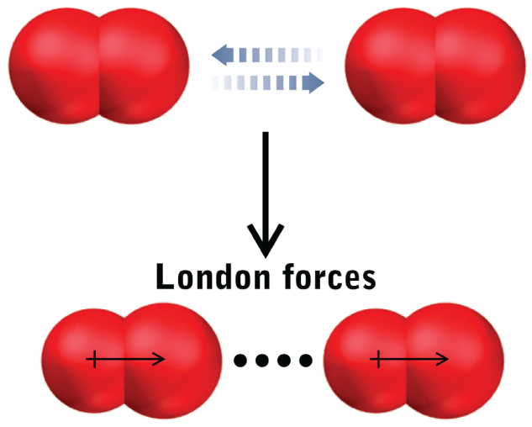
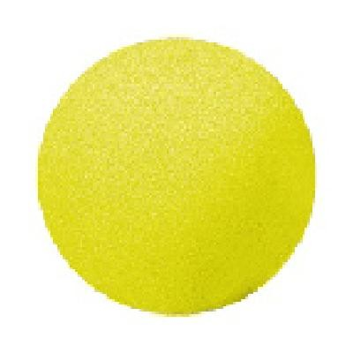
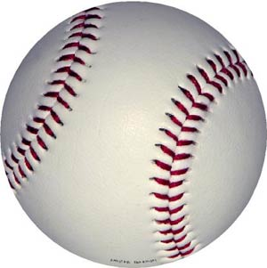
Polarizability
It is due to polarizability: distortion of the electron cloud around the
atom's nucleus as another atom or molecule approaches
Initially both O₂ molecules have the positive nucleus surrounded by a negative electron cloud
As they “see” each other the electron clouds repulse each other leaving a slightly exposed nucleus
This generates a short-lived or “induced” dipole
The larger the electron cloud the more “spongy” the atom/molecule is
This “sponginess” leads to a larger induced dipole and thereby makes the interactions stronger
He (0.0341 L² atm / mol²)
Ar (3.59 L² atm / mol²)

Slide 17
Induced Dipole↔Induced Dipole IF
AKA van der Waals, London dispersion, or dispersion forces
Repulsion between neighboring electron clouds induces a dipole
The more polarizable the atom/molecule the larger the induced dipole
The larger the induced dipole the stronger the IF between atoms/molecules
This is the only type of force present in non-polar molecules
However, all neutral atoms/molecules have this force it just tends to be weaker than all the other types

Slide 18
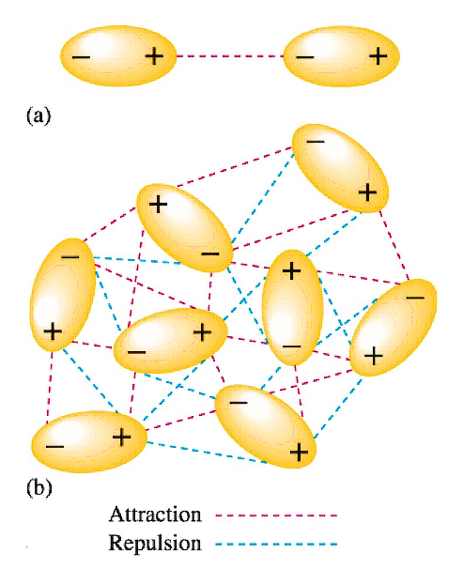
Dipole↔Dipole IF
“dipole” meaning it’s a polar molecule
Recall the overall dipole arrow from the methane trends
This gives a distribution of charge
Less EN side is partial (+)
More EN side is partial (-)
Dipole↔Dipole example: water with water
http://cationsanddogions.blogspot.com/
Comparison: Dipole↔Dipole > Induced-dipole ↔Induced-dipole
Where do you think Dipole↔Induced-dipole goes?
Dipole↔Dipole > Dipole↔Induced-dipole > Induced-dipole ↔Induced-dipole

Slide 19
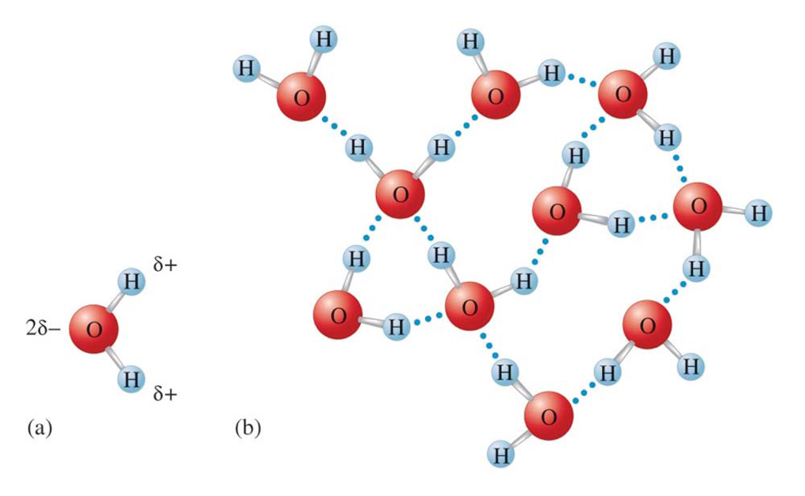
Hydrogen Bonding IF
Most powerful dipole-dipole
Occurs between molecules possessing H and either O, N, or F
Examples: H₂O↔H₂O, NH₃ ↔ NH₃, and HF ↔ HF
Generated by the close proximity of the lone pairs from the very EN atoms
The strength of this force leads to a number of interesting properties:
High boiling point of water
Double helix formation of DNA
What we have so far: H-bonding > Dipole↔Dipole > Dipole ↔Induced-dipole > Induced-dipole ↔Induced-dipole

Slide 20
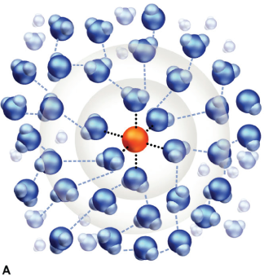
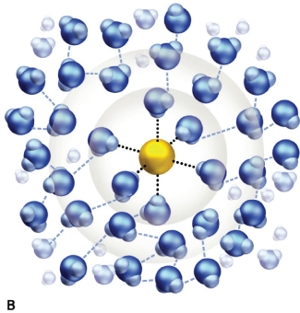
Ion↔Dipole IF
A. Na⁺↔O-atom
Occur between an ion and a polar molecule
The attractive forces between oppositely charged species forms the interaction
To the left we have NaCl in water
For A. the positive Na+ ion interacts with the partial negative on the O-atom
For B. the negative Cl- ion interacts with the partial positive on the H-atoms
Overall the higher the charge as well as the larger the dipole on the polar molecule will lead to a stronger intermolecular force
Now we have: Ion↔Dipole > H-bonding > Dipole↔Dipole > Dipole↔Induced-dipole > Induced-dipole ↔Induced-dipole
B. Cl─↔ H-atom

Slide 21
Non-Polar vs. Polar and IF
Non Polar Molecules
Have same molecular & electronic geometries
Are completely symmetric
May possess polar bonds (e.g. CCl₄)
Only experience dispersion forces
Polar Molecules
May the same (CH₃Cl) or different (NH₃) molecular & electronic geometries
May have lone pairs on the central atom (e.g. H₂O)
Are not completely symmetric
Must possess polar bonds
Experience at least dipole-dipole interactions

Slide 22
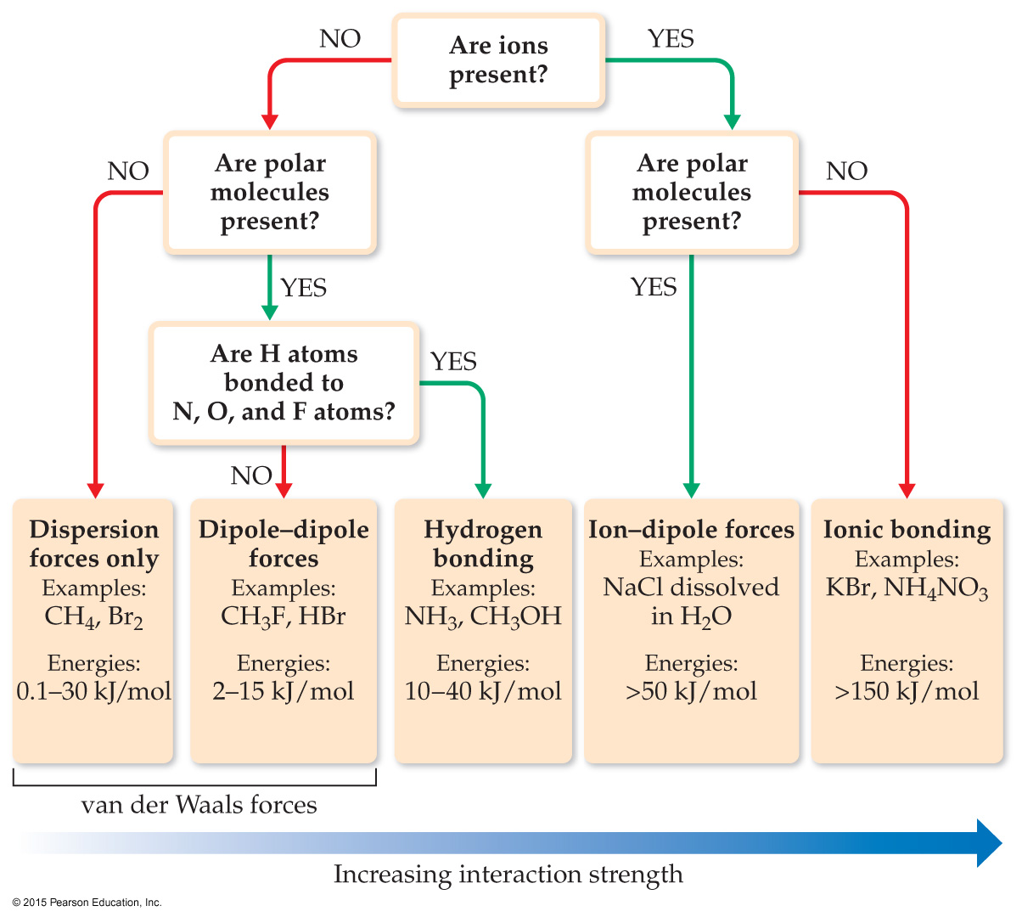
Comparing Intermolecular Forces

Slide 23
Name the strongest IF in:
Polar(P)/Nonpolar(NP) Strongest IF
F₂
NP
Dispersion forces
CH₃OH
P
H-bonding
CsBr in H₂O
Ionic/P
Ion-dipole
X 6

Slide 24
Section 11.3
Select Properties of Liquids

Slide 25
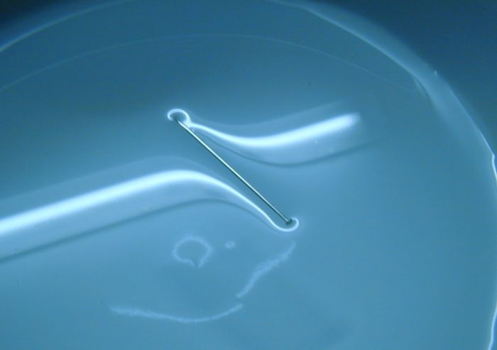
Surface Tension
Defn: amount of energy needed to separate atoms/molecules at the surface of a liquid
A cold needle even if it is more dense than water will float on the surface
When we heat the needle up it will sink as it has the energy to break the Ifs between the atoms/molecules
For water this occurs due to the strength of the H-bonds between molecules
http://commons.wikimedia.org/wiki/File.Aguja_tens_sup.jpg

Slide 26
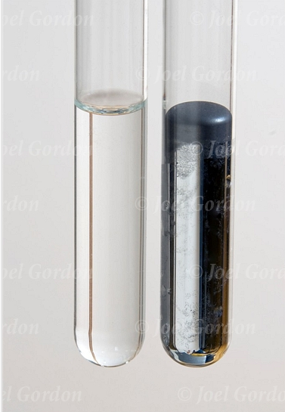
Meniscus
Defn: curve of the top of a liquid when in a container
Results from forces between the liquid molecules with themselves and liquid molecules with the container
Cohesive forces: occur between the same molecules (right: H₂O with H₂O and left: Hg₂ with Hg₂
Adhesive forces: occur between different molecules (left: H₂O with glass and right: Hg₂ with glass)
The larger the difference in these two forces the more distinct the curve
www.photoshelter.com/image/10000PEyxG9NfTYA

Slide 27
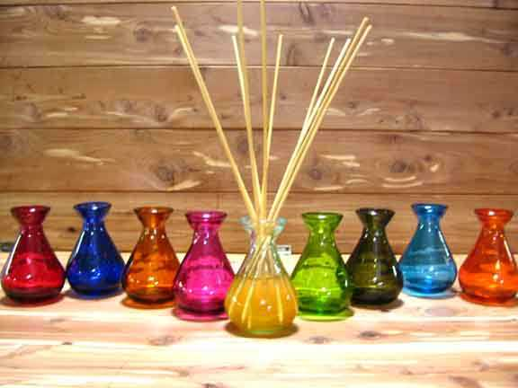
Capillary Action
Defn: rise of a liquid up a narrow tube
As with meniscus it results from forces between molecules
Cohesive forces between liquid molecules
Adhesive forces between liquid and solid molecules
Real life example: it is how plants get their water
www.candle-licious.com/page/C/PROD/Flameless/ReedDiffuser

Slide 28
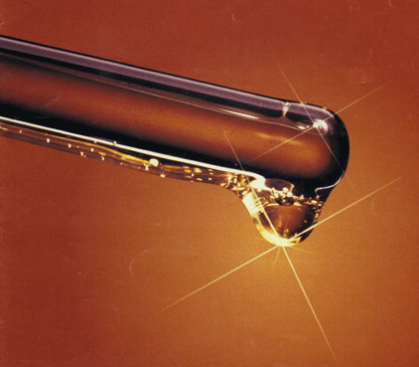
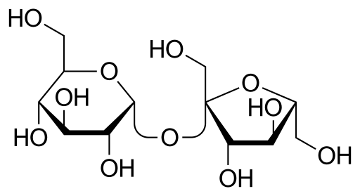
Viscosity
Defn: the resistance by a liquid to flow
Molasses is very thick and doesn’t want to flow due to the larger number of OH groups on each molecule making multiple Hbonds with their neighbors
As was the case with surface tension, heating up the container will break the intermolecular forces and cause it to flow over our pancakes
https://en.wikipedia.org/wiki/Sucrose
syntheticlubricants.ca/Pics/viscosity.gif

Slide 29
Properties of Liquids & IFs
The stronger the IF:
The larger the surface tension
The greater the viscosity
Relating this to one of the last Kahoot! questions - which compound has the largest intermolecular force?
Hence:
H₂S will have the largest surface tension and the greatest viscosity
If we rank them in order from lowest to highest viscosity:
Ne < CCl₄ < NO < H₂S
H₂S CCl₄ Ne NO
X 3

Slide 30
Section 11.4
Phase Changes

Slide 31
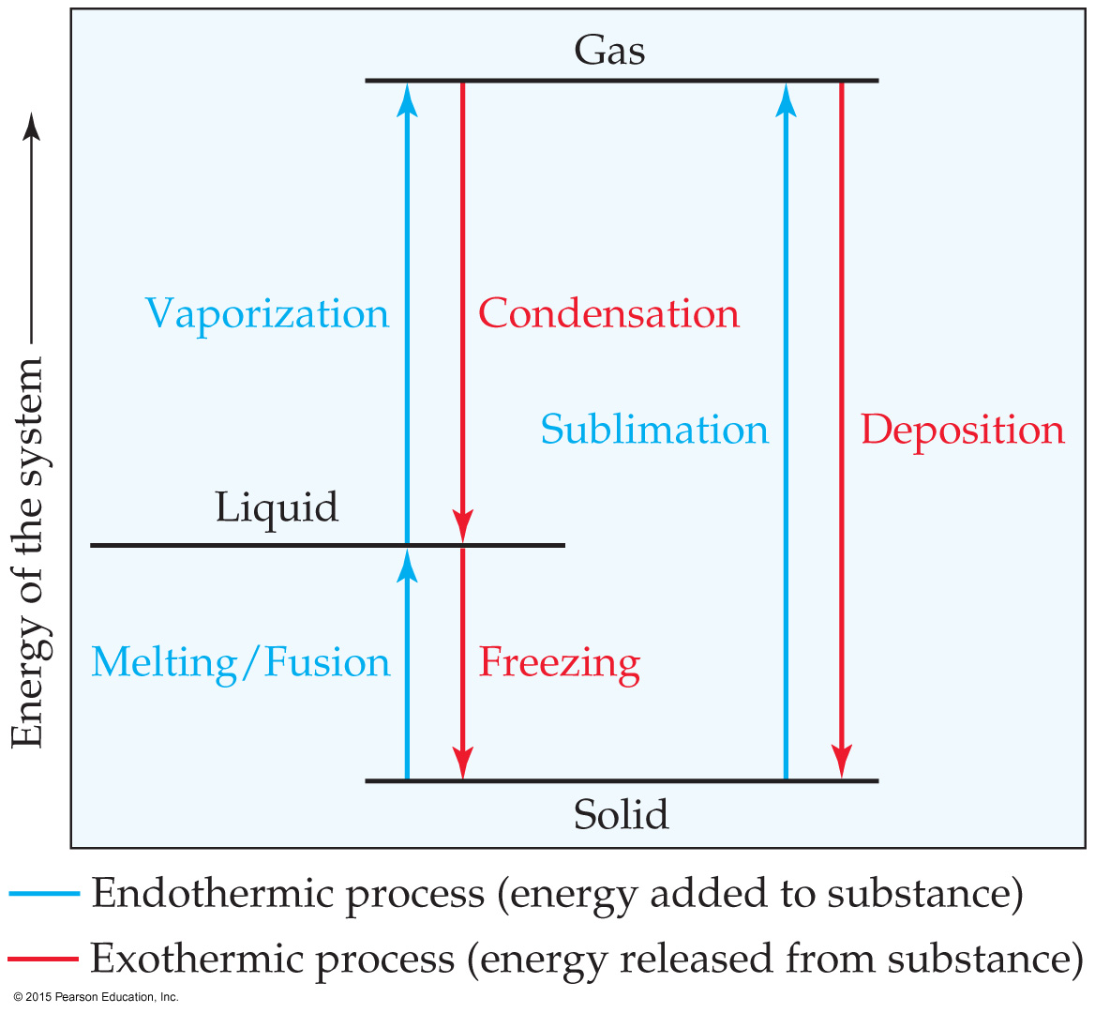
Energy & Phase Changes
Conversion from one state of matter to another is called a phase change.
Energy is either added or released in a phase change.
Phase changes: melting/freezing, vaporizing/condensing, subliming/depositing.

Slide 32
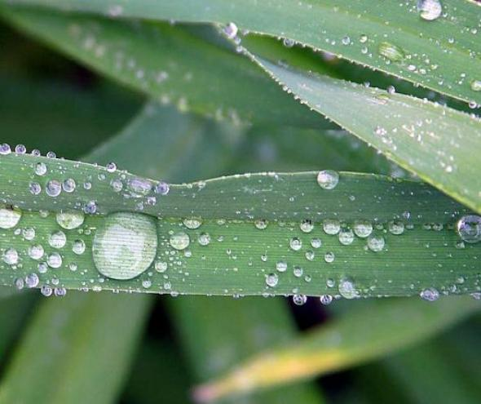
Changes of State & IF
Sublimation: s → g, endothermic process
Solidification: g → s or l → s, exothermic process
Melting: s → l, endothermic process
As was the case with vaporization they all have corresponding ΔH
Final Note: to go from one state to another we must overcome or form the intermolecular forces involved
www.instablogsimages.com/images/2010/03/02/ha..

Slide 33
Changes of State & IF
The higher the IF the:
The higher the bpt
The higher the mpt
Relating this to a previous example:
H₂S will have the highest bpt and the highest mpt
If we rank them in order from lowest to highest VP:
Ne < CCl₄ < NO < H₂S
H₂S CCl₄ Ne NO

Slide 34
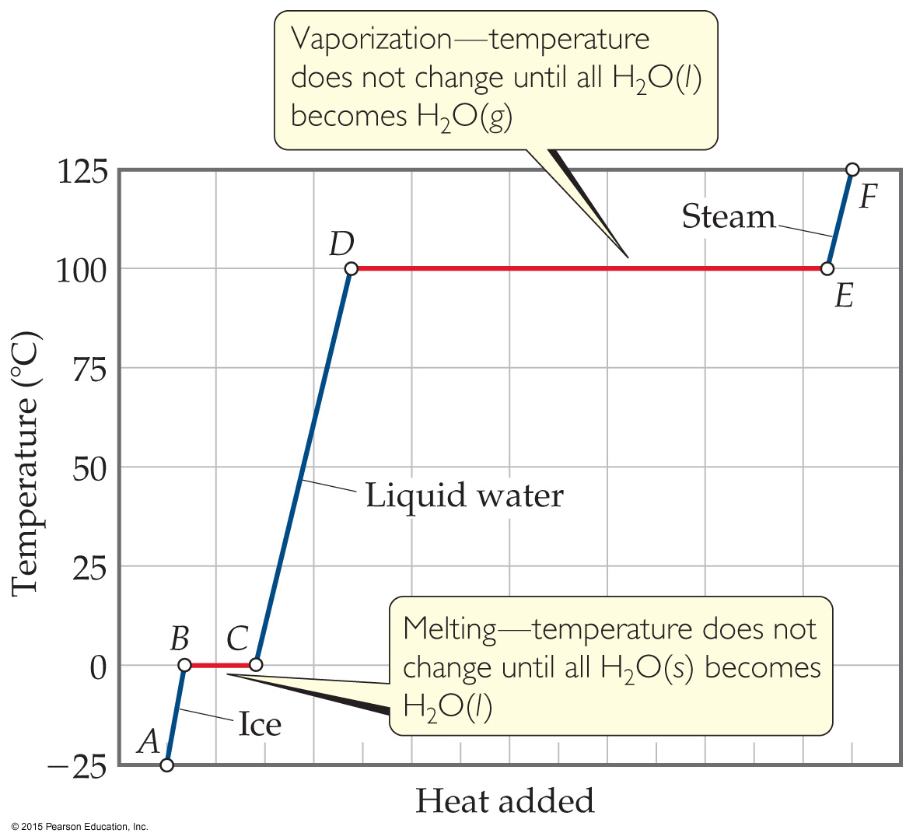
Heating Curves
A plot of temperature vs. heat add is called a heating curve.
Within a phase, heat is the product of specific heat, sample mass, and temperature change.
The temperature of the substance does not rise during a phase change.

Slide 35
Critical Temperatures & Pressures
All substances have a T & P in which the liquid and gas phases are completely indistinguishable this is called the critical point
The density is the same for both states
The liquid phase is less dense due to high T
The gas phase is more dense due to high P
The name we give to this state is supercritical fluid
X 3

Slide 36
Section 11.5
Vapor Pressure

Slide 37
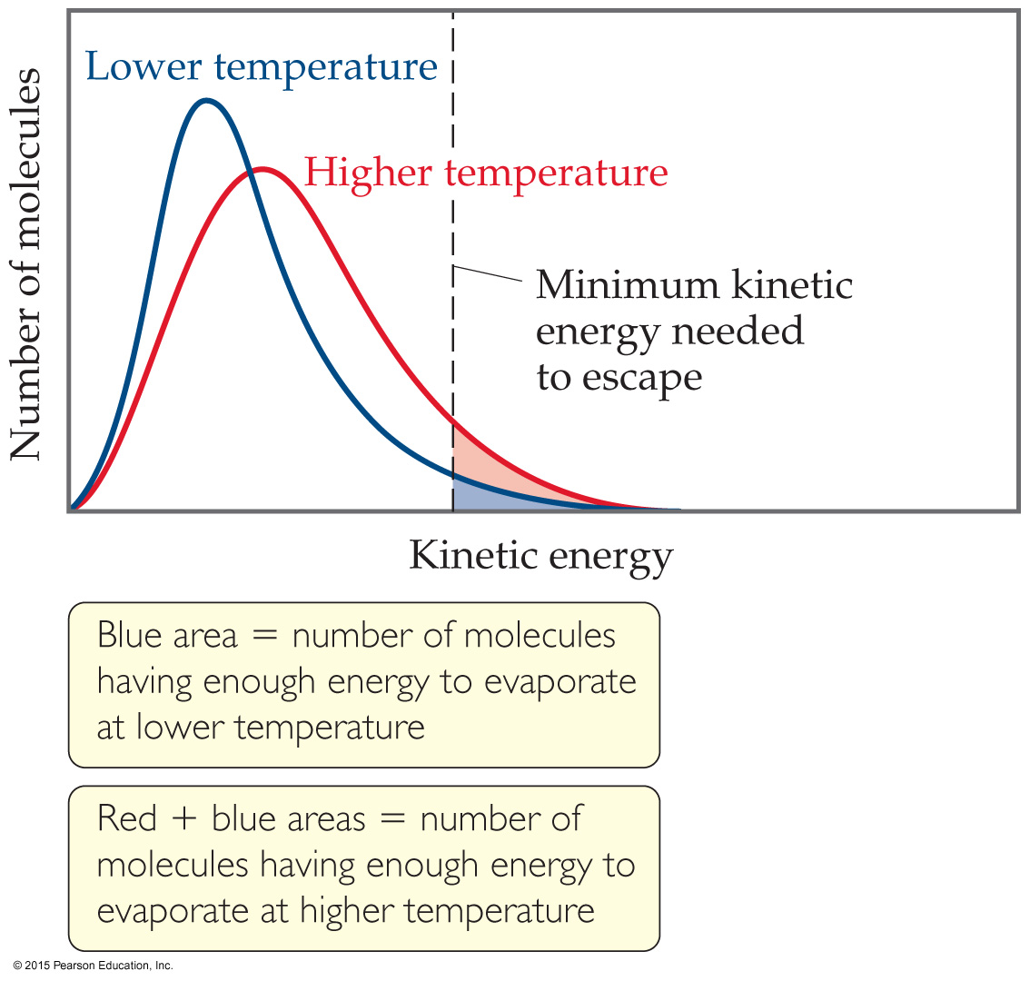
Vapor Pressure
At any temperature, some liquid molecules have enough energy to escape the surface and become a gas.
As the temperature rises, the fraction of molecules that have enough energy to break free increases.

Slide 38
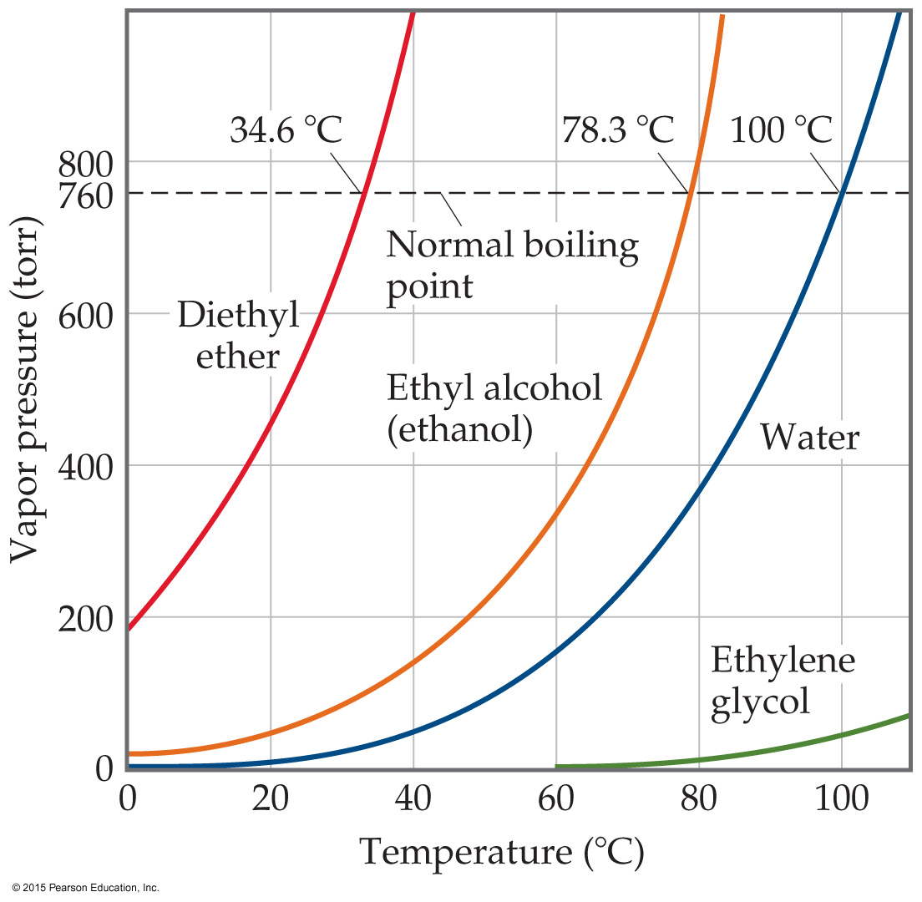
Vapor Pressure & Boiling Point
The boiling point of a liquid is the temperature at which its vapor pressure equals atmospheric pressure.
The normal boiling point is the temperature at which its vapor pressure is 760 torr.

Slide 39
Vapor Pressure & IF
VP is the one where we end up going backwards – this will be more clear after we get to Chapter 13
The lower the VP the higher the intermolecular force
The higher the VP the lower the intermolecular force
Relating this to our earlier example:
H₂S will have the lowest VP
If we rank them in order from lowest to highest VP:
H₂S < NO < CCl₄ < Ne
H₂S CCl₄ Ne NO

Slide 40
Calculating ΔH_{vap}
For a list of vapor pressures at different temperatures:
If there are two vapor pressure as well as their corresponding temperatures:

Slide 41
Example Calculation
What is the heat of vaporization of X if the vapor pressure at 0⁰C is 250 torr and the vapor pressure at 100⁰C is 500 torr? (answer: 5.90 kJ/mol)
X 5

Slide 42
Section 11.6
Phase Diagrams
Graphical representations of physical states as function of T & P

Slide 43
Intermolecular Forces & Phases
Intermolecular forces, temperature and pressure all contribute to what phase is preferred
At lower T & P gases are preferred
At lower T but higher P solids are preferred
Liquids tend to be preferred at higher T and higher P

Slide 44
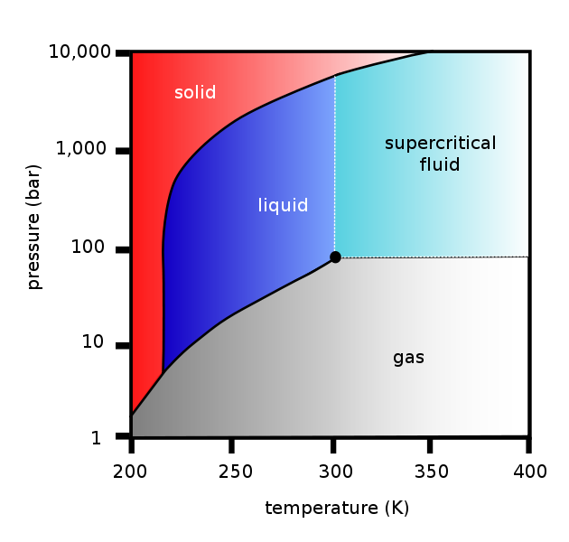
Carbon Dioxide Phase Diagram
As promised:
the solid in red is low T but high P
The gas in grey is low T & P
The liquid in blue is between the two
The solid line separating the solid and liquid is the melting/freezing pt line
The small line between red and grey is the sublimation pt line
The line between blue and grey is the boiling point line
www.sciforums.com/showthread.php?p=2060322

Slide 45
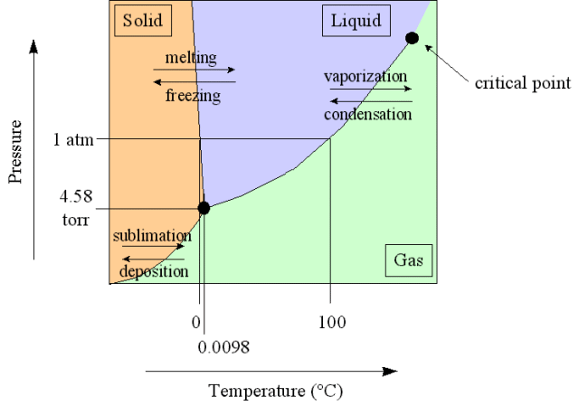
Water – Another Example
Points in the Diagram
Triple point (s, l & g) phases – only happens once in a diagram
Critical point (l & g)
The two phases are indistinguishable
Fluid phase: occurs above critical point and means the density for both l & g are the same
Normal points occur at P = 1 atm
Boiling point is T at 1atm (e.g. water is 100⁰C)
Freezing point is T at 1atm (e.g. water is 0⁰C)
bhs.smuhsd.org/.../apchemistry/h2ophase.gif
Unique to water and other H-bonding liquids:
Negative slope in melting point line
This downward slope leads to ice melting in the freezer

Slide 46
Section 11.7
Skip – YIPPEE!!!

